Slide 1
Database Management
Systems

Slide 2
Contents:
SQL
Domain type in SQL
Creating a Database
Operation on database

Slide 3
What is a relational database?
Relational DB
  Relational Database Management System (RDBMS) consists of
    A set of tables
    A schema
A schema:
  is a description of data in terms of data model
  Defines tables and their attributes

Slide 4
What is a relational database?
Tables ≡ relation:
  Stores information about an entity or theme–Consist of columns (fields) and rows (records).
  Rows ≡ tuple, describing information about a single item, eg. A specific student
  columns ≡ attributes, describing a single characteristic (attributes) of its item, eg. Its ID number, GPA, etc
  Every row is unique & identified by a key

Slide 5
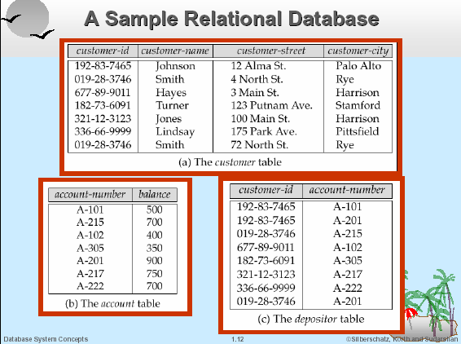
Example

Slide 6
Data Types & Basics
Data Types
  Integers: TinyInt, SmallInt, MediumInt, Int, BigInt
  Real Numbers: Float, Double, Decimal, Real
  Time: Date, DateTime, Timestamp, Time,
  String: Char, VarChar
  Text: TinyText, MediumText, LongText
CSE 498
Day 3 - Basics of MySQL
<number> / 8

Slide 7
Query Language
A query language is a language in which a user requests information from the database.
    Procedural Language
    Nonprocedural Language

Slide 8
Structured Query Language(SQL)
SQL is the most influential commercially marketed query language.
This is not just query language
It can define the structure of the data, modify data in the database and specify security constraints
SQL has become the standard relational database language

Slide 9
SQL
SQL language has several parts:
  DDL
  DML
  Integrity
  View definition
  Transaction control
  Embedded SQL
  Authorization

Slide 10
Data Definition Language (DDL)
Specifies the set of relations in a database
It keeps the following information about each relation such as:
The schema for each relation
The domain of values associated with each attribute.
Integrity constraints
The set of indices to be maintained for each relations
Security and authorization information for each relation.
The physical storage structure of each relation on disk.

Slide 11
Basic Domain Types
char(n) | A FIXED length string The size parameter specifies the column length in characters Can be from 0 to 255. Can contain letters, numbers, and special characters branch_city char(30),
VARCHAR(n) | A VARIABLE length string The size parameter specifies the maximum column length in characters Can be from 0 to 65535 Can contain letters, numbers, and special characters). name VARCHAR(20)
TEXT(size) | Holds a string with a maximum length of 65,535 bytes

Slide 12
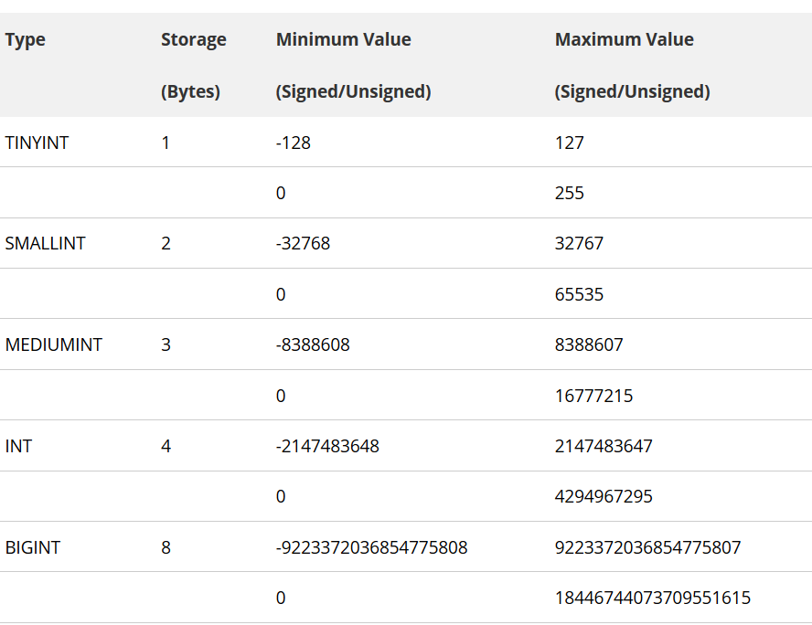
Basic Domain Types

Slide 13
Basic Domain Types
FLOAT(M,D) − | A floating-point number. display length (M) and the number of decimals (D). Decimal precision M can go to 24 places for a FLOAT.
DECIMAL(M,D) | M precision that represents the number of significant digits. The range of M is 1 to 65. The range of D is 0 and 30. DECIMAL(19,9) has 9 digits for the fractional part and 19-9 = 10 digits for integer part.

Slide 14
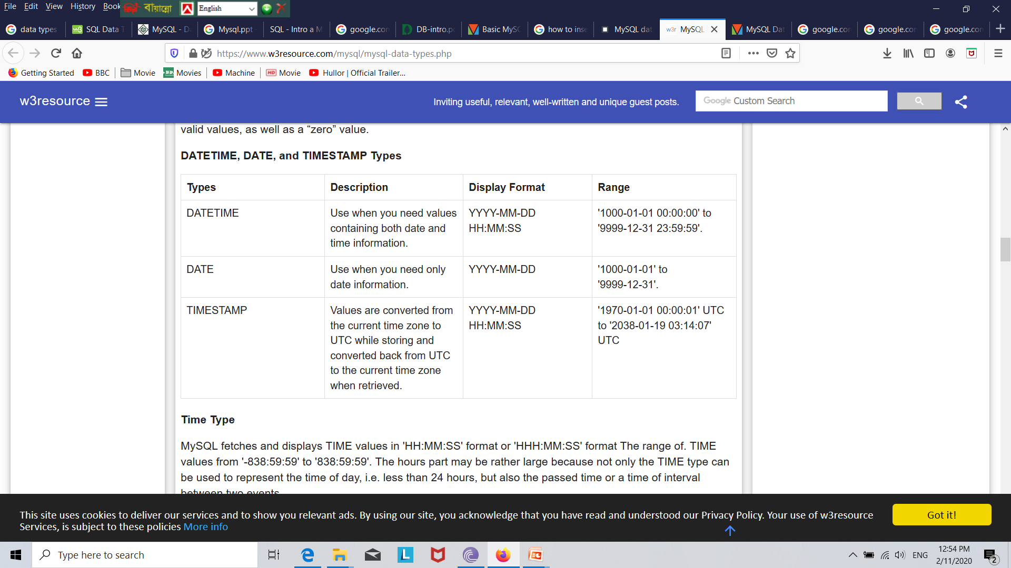
Basic Domain Types

Slide 15
SQL
SQL CREATE DATABASE Statement
  CREATE DATABASE database_name
  Example: CREATE DATABASE my_db
  SQL CREATE Table Statement
    We define a relation by create table command
    create table r (A1 D1, A2 D2, ..., An Dn,
(integrity-constraint1),
...,
(integrity-constraintk));
r is name of relation/table
A is name of attribute
D is the domain type
integrity-constraints include primary key, foreign key

Slide 16
SQL
SQL CREATE table Statement
    We define a relation by create table command
    In easy way:
    CREATE TABLE table_name
    (
    column_name1 data_type,
    column_name2 data_type,
    column_name3 data_type,
    ....
    );

Slide 17
SQL
SQL CREATE table Statement
    We define a relation by create table command
    Example:
      create table branch (
      branch_name char(15) not null,
      branch_city char(30),
      assets numeric(16,2),
      primary key (branch_name),
      check (assets >= 0));

Slide 18
SQL
SQL Insert data Statement
    INSERT INTO table_name
    VALUES (value1, value2, value3,...);
    Example:
      INSERT INTO branch
      VALUES (‘Mogbajar', ‘Dhaka', 1200);

Slide 19
END

